Slide 1
Multi vector processor and SIMD processor

Slide 2
>A multi-vector processor system, or Chip Multi-Vector Processor (CMVP), enhances computational performance by combining multiple vector processing units (PUs) or cores on a single chip, specifically targeting high-performance, parallel workloads like scientific simulation and image processing. >These systems utilize shared vector caches and high-bandwidth memory to overcome bottlenecks associated with increased core counts.

Slide 3
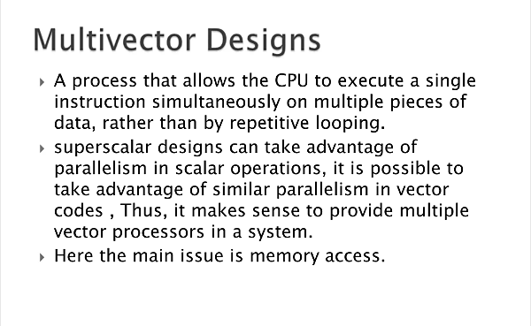

Slide 4
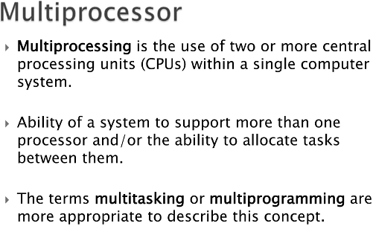

Slide 5


Slide 6
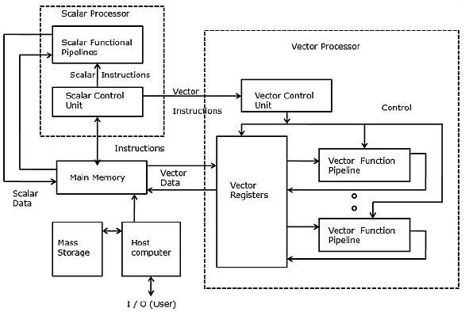
Vector Multiprocessor

Slide 7
SIMD computers
SIMD means single instruction stream and multiple data stream.
These computers are array processors. There are multiple processing elements which are supervised under same control unit.
Each processing element receives same instruction but operate on different data from distinct module.
In SIMD computers, ‘N’ number of processors are connected to a control unit and all the processors have their individual memory units.
All the processors are connected by an interconnection network.

Slide 8
SIMD Machine Model
An operational model of an SIMD computer is specified by 5 Triple. [ N, C, I, M, R]
Where
N is the number of processing elements (PEs) in the machine.
C is the set of instructions directly executed by control unit including scalar and program flow control instructions.
I is set of instructions broadcast by CPU to all PEs for parallel execution. These include arithmetic, logic, data routing, masking and other local operations executed by each active PE over data within that PE.
M is the set of masking schemes, where each mask partitions the set of PEs into enabled & disabled subsets.
R is the set of data routing functions, specifying various patterns to be set up in the inter connection network for inter PE communications.

Slide 9
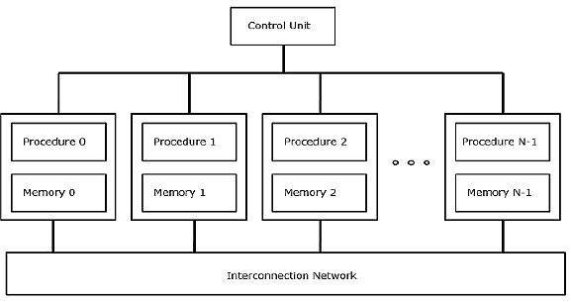
SIMD Computer

Slide 10
SIMD Computer organization
vector processing can also be carried out using SIMD computers.
Most SIMD computers uses a single control unit and distributed memories, except for a few that uses associative memory.
Associative memory search the content directly instead of searching the memory address.
The processing elements (PEs) in the SIMD computers are passive ALUs executing instructions broadcast from the control unit.
Passive ALU vs. Active CPU
Active ALU (Standard CPU): Independently fetches, decodes, and executes its own instructions.
Passive ALU (SIMD): Executes only what it is told to do by the controller. This design allows for a much higher number of PEs on a chip because the complex control logic is removed from each PE and centralized.

Slide 11
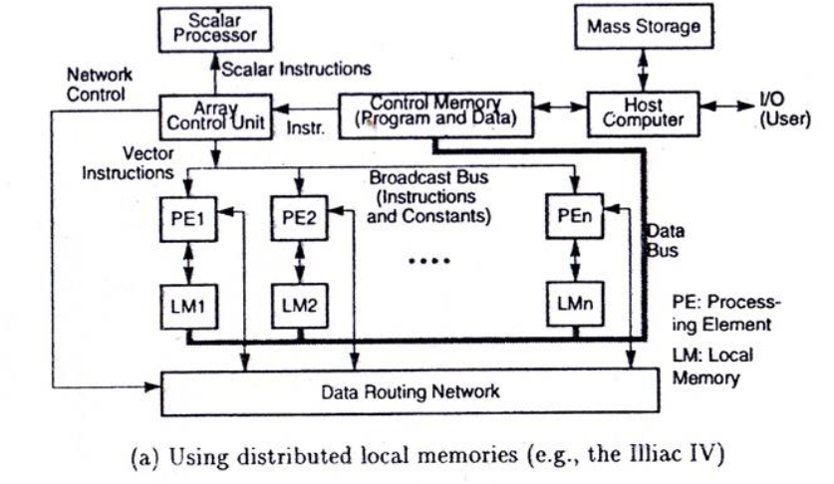
Distributed memory model of SIMD computer
a distributed memory SIMD computer consists of an array of processing elements which are controlled by the single array control unit.

Slide 12
The program and data are loaded into the control memory through the host computer.
An instruction is sent to the control unit for decoding. If it is a scalar or program control operation, it will be directly executed by a scalar processor attached to the control unit.
If the decoded instruction is a vector operation, it will be broadcast to all the PEs for parallel execution. The partitioned data sets are distributed to all the local memories attached to the PEs through a vector data bus.
The PEs are interconnected by a data routing network which performs inter PE data communications such as shifting, permutation and other routing operations.
The data routing network is under program control through the control unit.
the masking logic is provided to enable or disable any PE from an participation in a given instruction cycle.

Slide 13
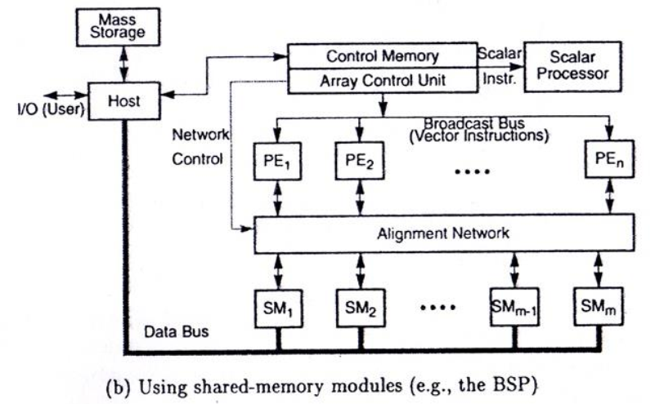
Shared memory model of SIMD computer

Slide 14
An alignment network is used as the inter PE memory communication network. The alignment network must properly set to avoid access conflicts.
SIMD instructions SIMD computers can execute vector instructions for arithmetic, logic, data routing and masking operations over vector quantities.
In bit slice SIMD machines the vectors are nothing but binary vectors.
In word-parallel SIMD machines , the vector components are 4 or 8 byte numerical values.
ALL SIMD instructions must use vector operands of equal length n, where n is the number of Pes. The functions used in SIMD are permutations, broadcasts, multicasts, rotate and shift operations.
HOST and I/O All I/O activities are handled by the host computer in the SIMD organizations. A special control memory is used between the host and the array control unit. The data sets are distributed to the local memories or to the shared memory modules before starting of the program execution. The host manages the mass storage and graphics display of computational results.

